Slide 1
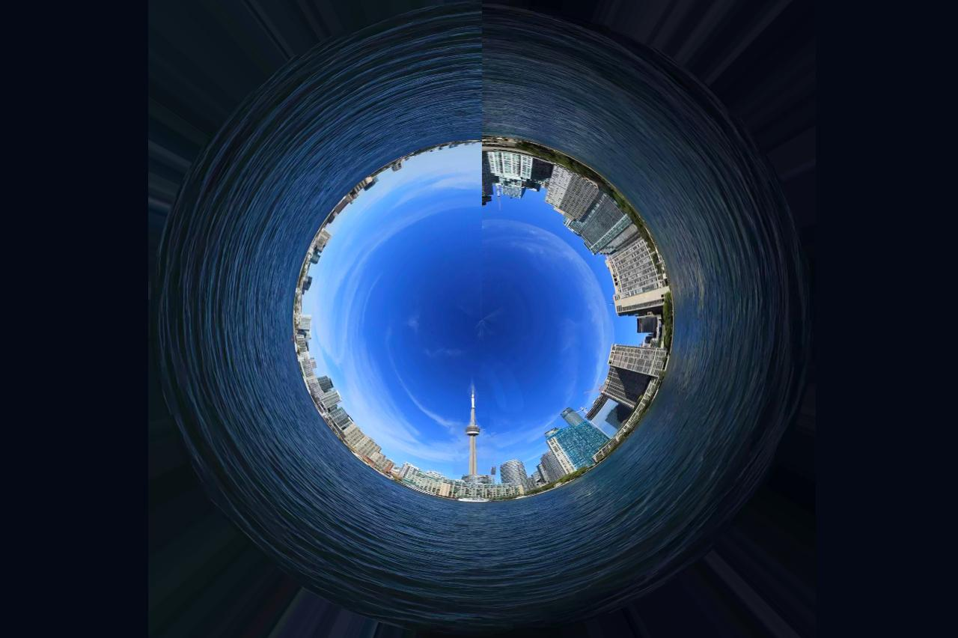
Final Presentation
Tourism Map:
S
Final Presentation
A Tourism Map:
Special Features, Algorithms
And Future Plans
Team #93
Jixiong (Jason) Deng
Tony Wang
Yuxi (June) Cai

Slide 2
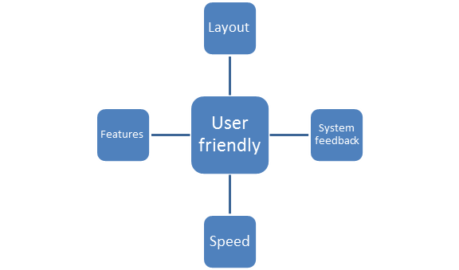
Design Principles
Tony Wang

Slide 3
Presentation Agenda
GIS demonstration
Features of our design
Technical aspects
What do we have in mind for the future?
Questions and answers

Slide 4
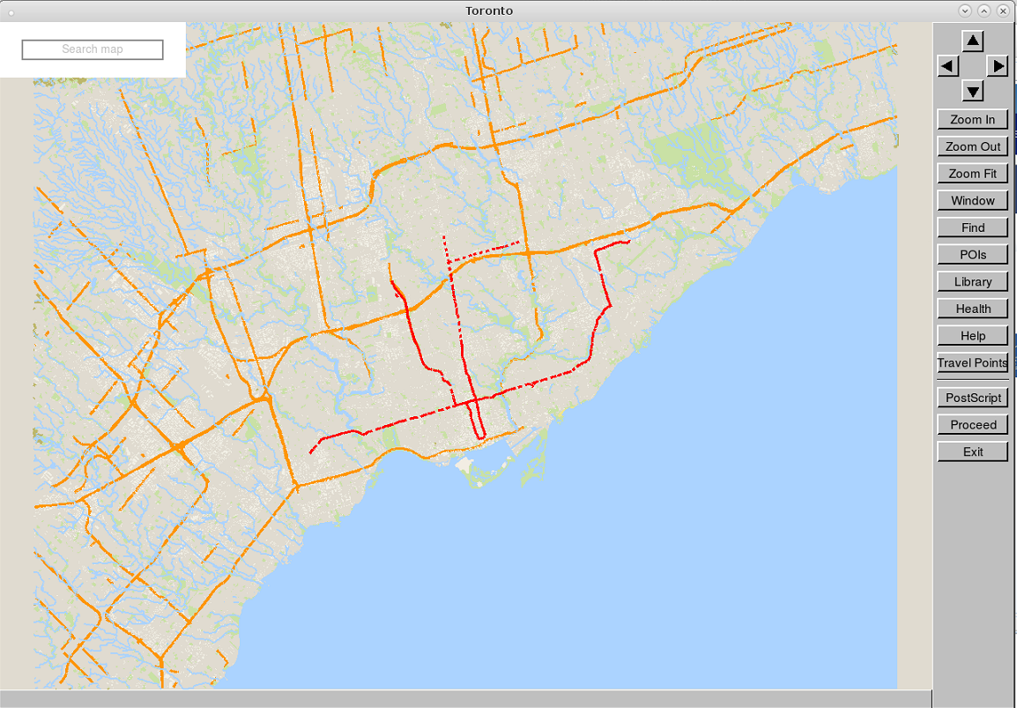
Current Design - Map for travellers
Yuxi (June) Cai
Finding A Destination
Finding A Path
Subway
Navigation Information for drivers
Search bar
Figure 1: An Overview of our map

Slide 5
To find a destination on our map
Search Bar
Yuxi (June) Cai
Look up point of interest (POI)
Interact with the map directly without going back and forth between the map and the terminal
Figure 2: A inactive search bar

Slide 6
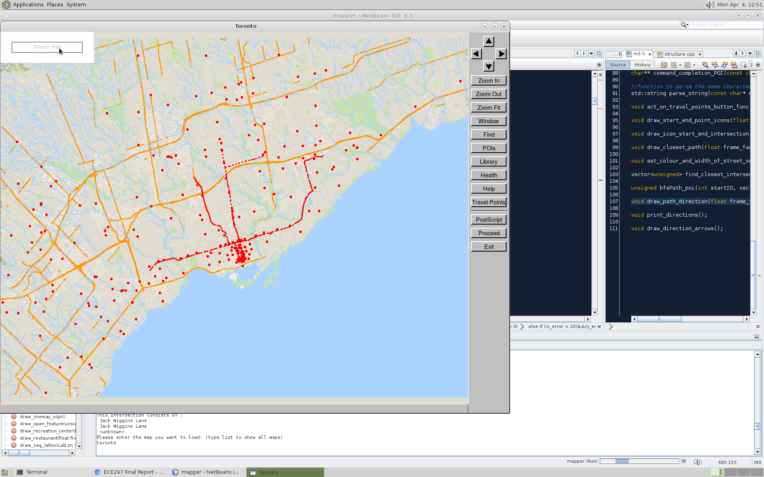
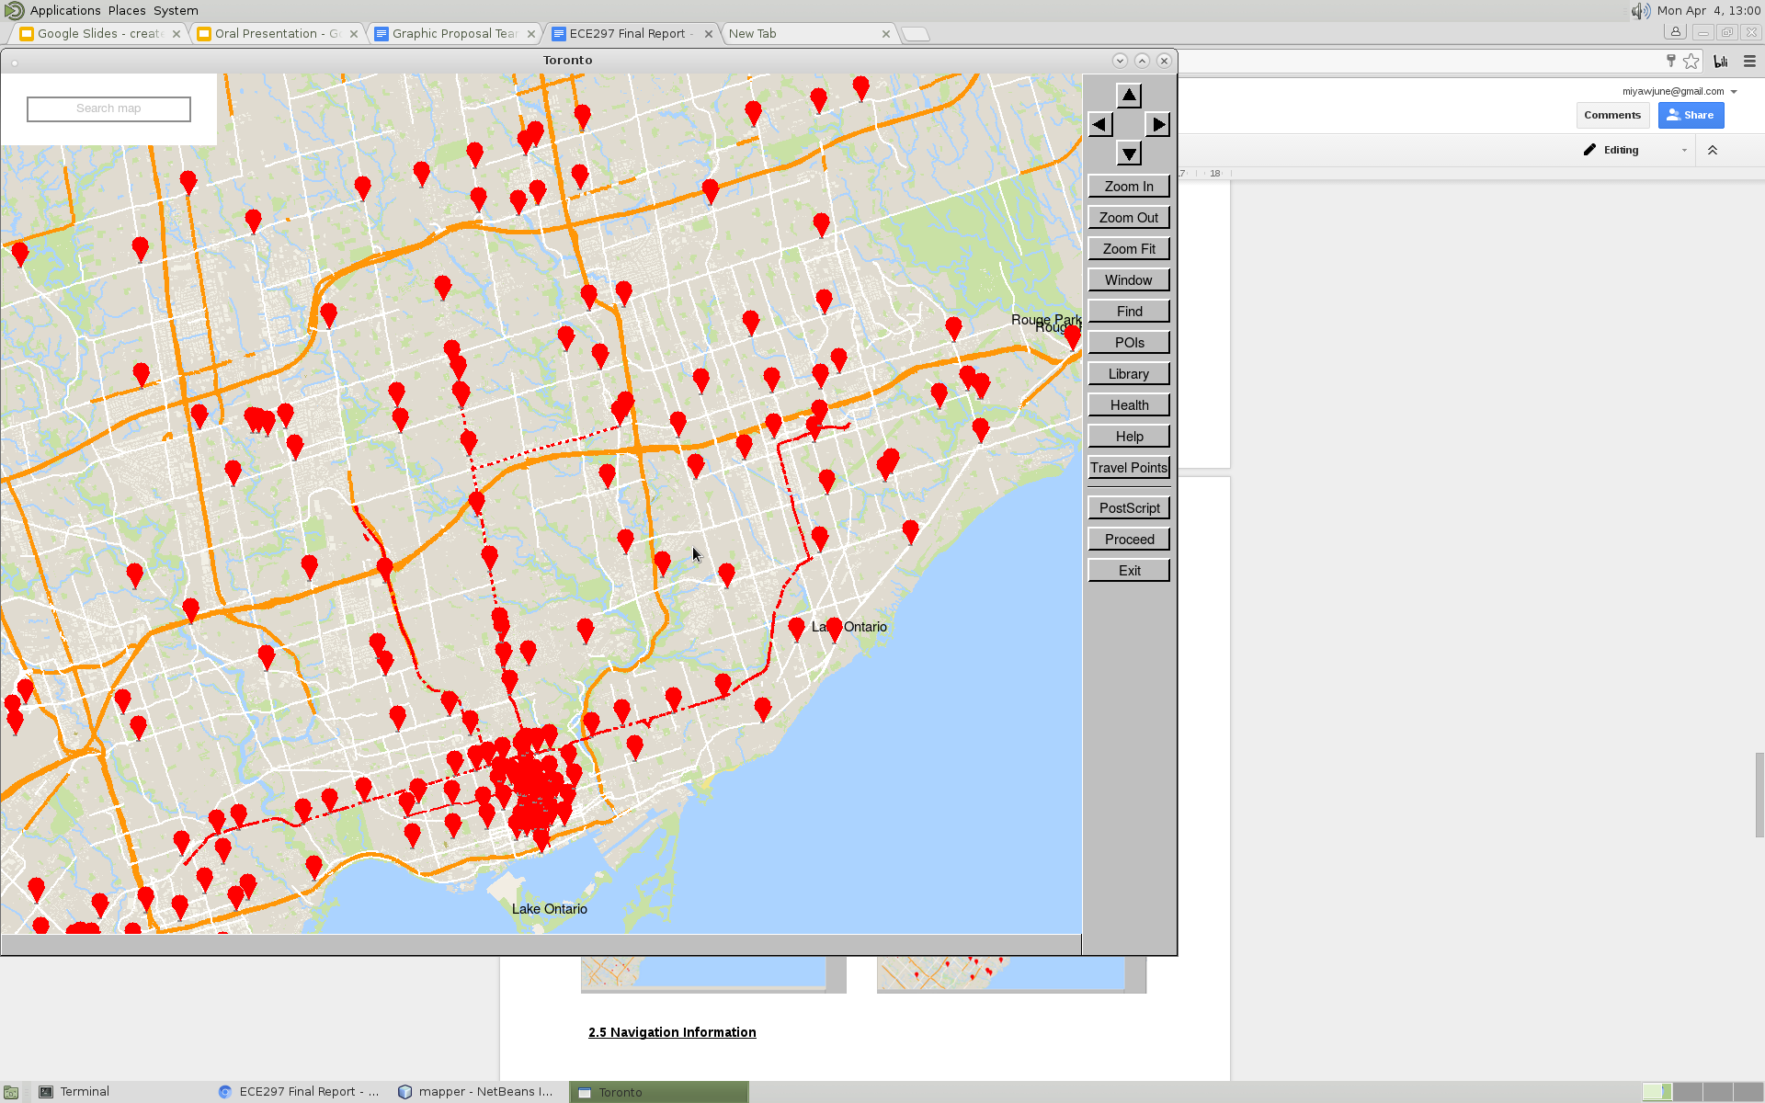
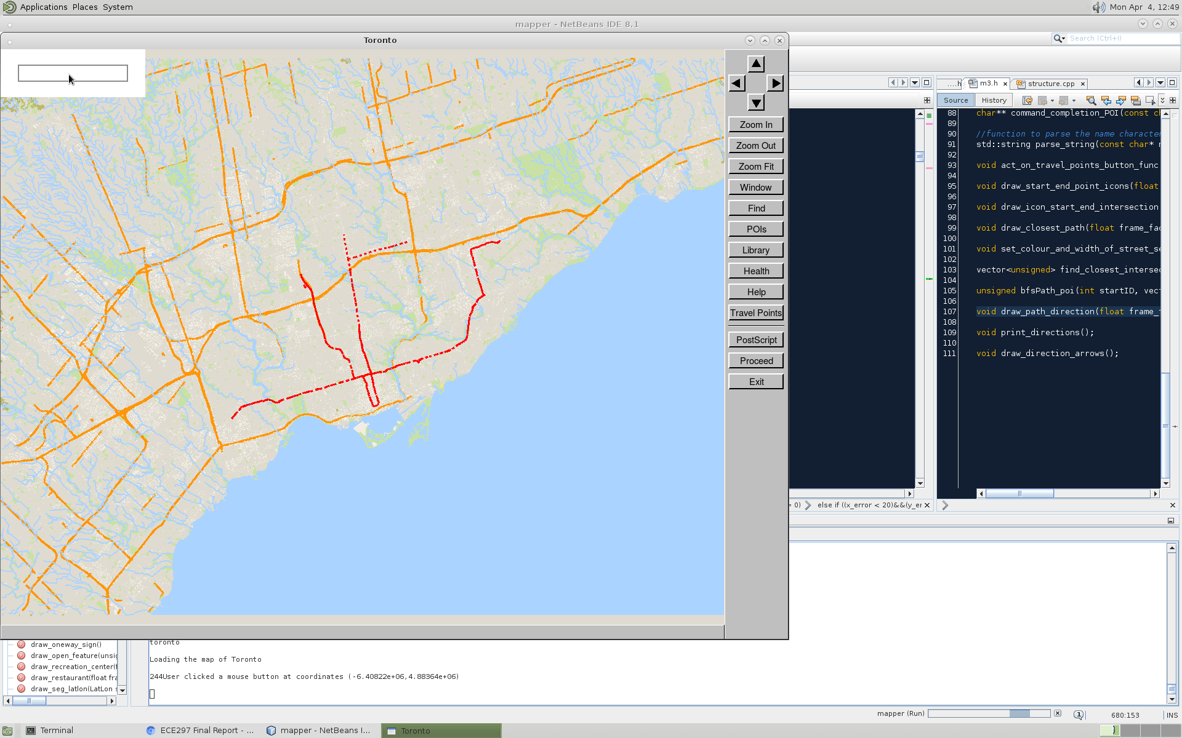

To find a destination on our map
Search Bar
Yuxi (June) Cai
Easy to operate
Locate all the points of interest with the same name
Figure 2-5: Search bar operations and reactions

Slide 7
To find a destination on our map
Search Bar
Yuxi (June) Cai
Enter
Parse the chars into string
Compare with POI names in structure
A key press from keyboard
Other keys
Discard the input
wait for another input
Letters and Numbers
Push the character into the char vector, redraw

Slide 8
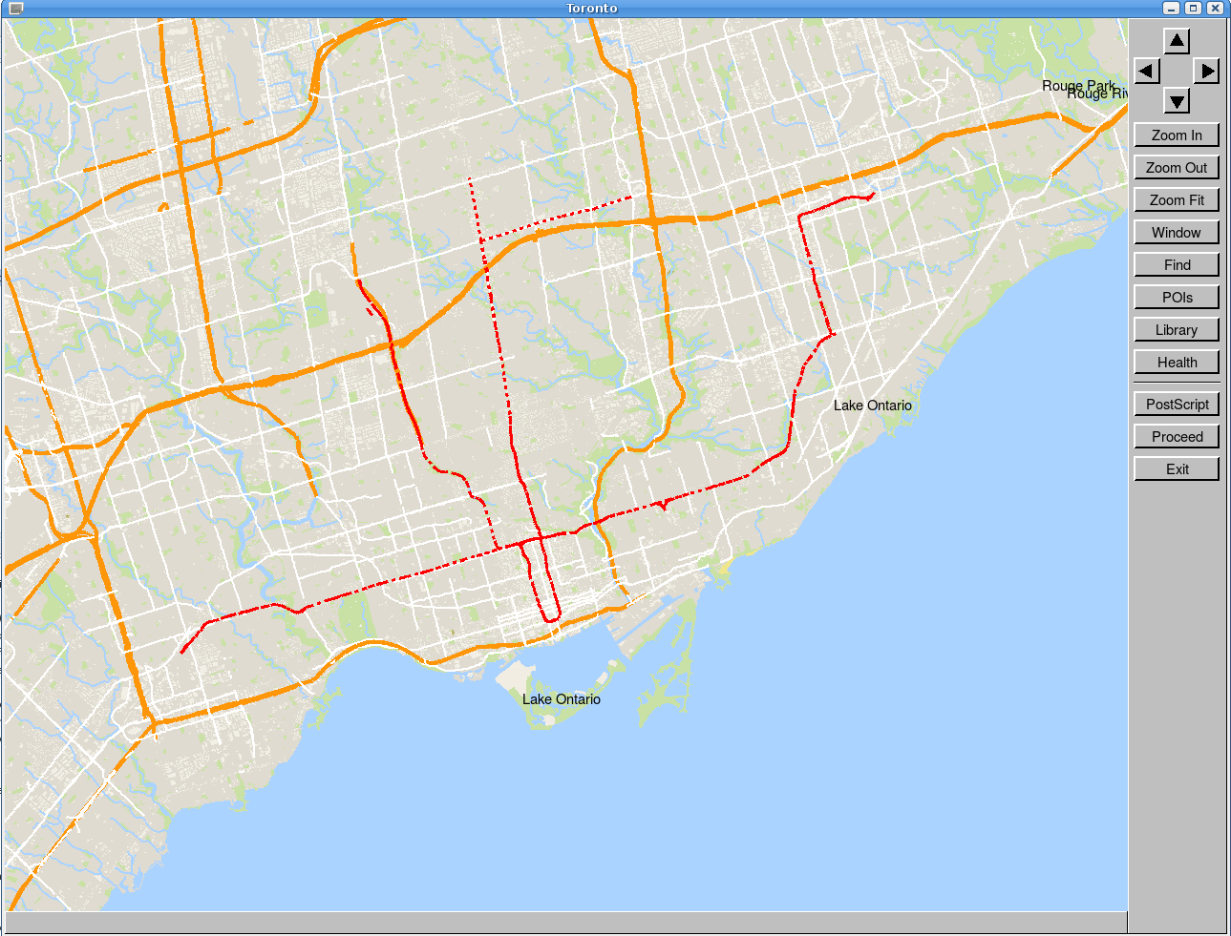
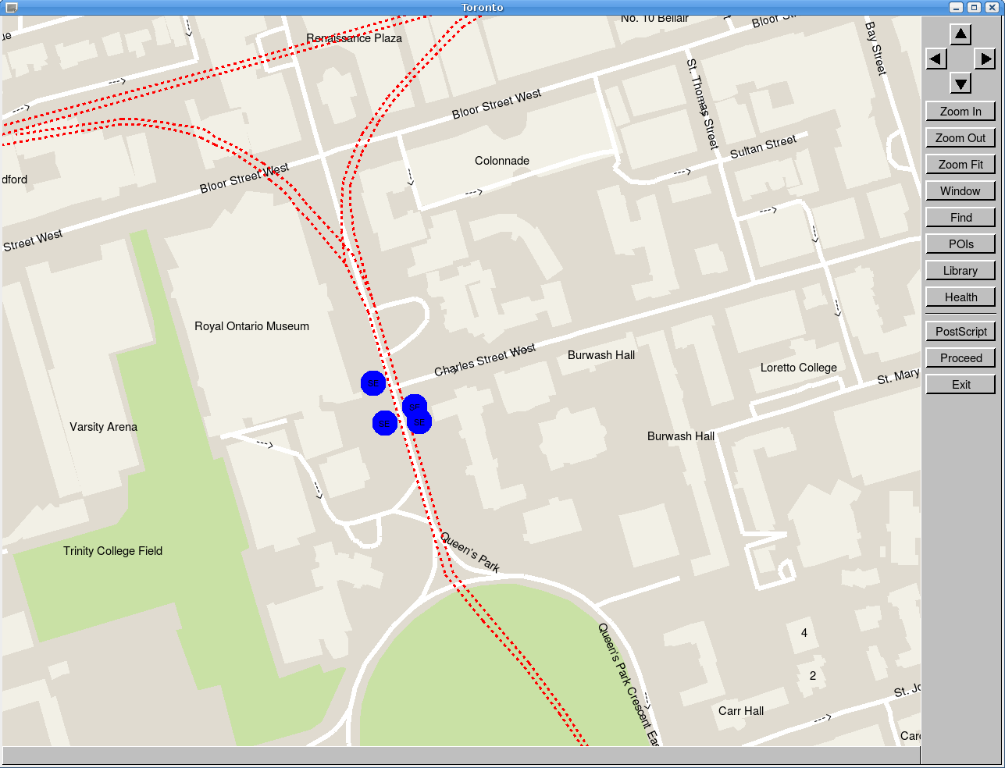
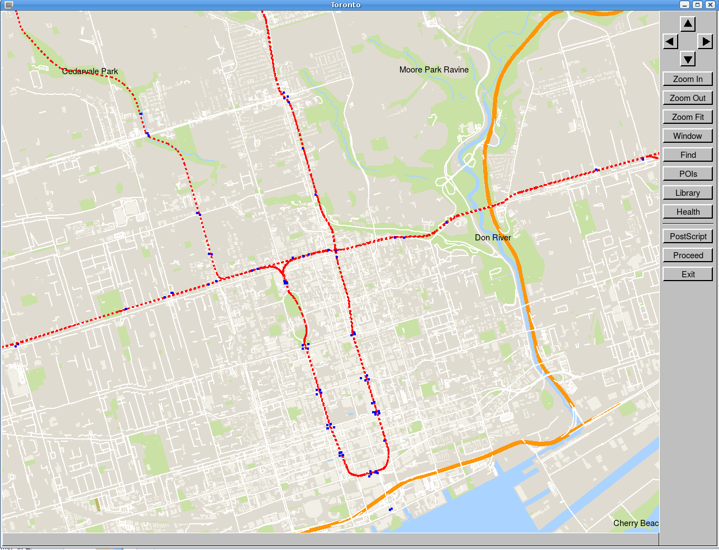
Subway
To travel with our map
Yuxi (June) Cai
One of the fastest expanding public transport methods since 1980s [1]
Show different details in different zoom levels
Figure 6-8: Subway displays
[1] UITP (International Association of Public Transport). (2014, October). “Statistics Briefs: World Metro Figures” [Online] Accessed April 6, 2016. Available: http://www.uitp.org/sites/default/files/cck-focus-papers-files/Metro%20report%20Stat%20brief-web_oct2014.pdf

Slide 9
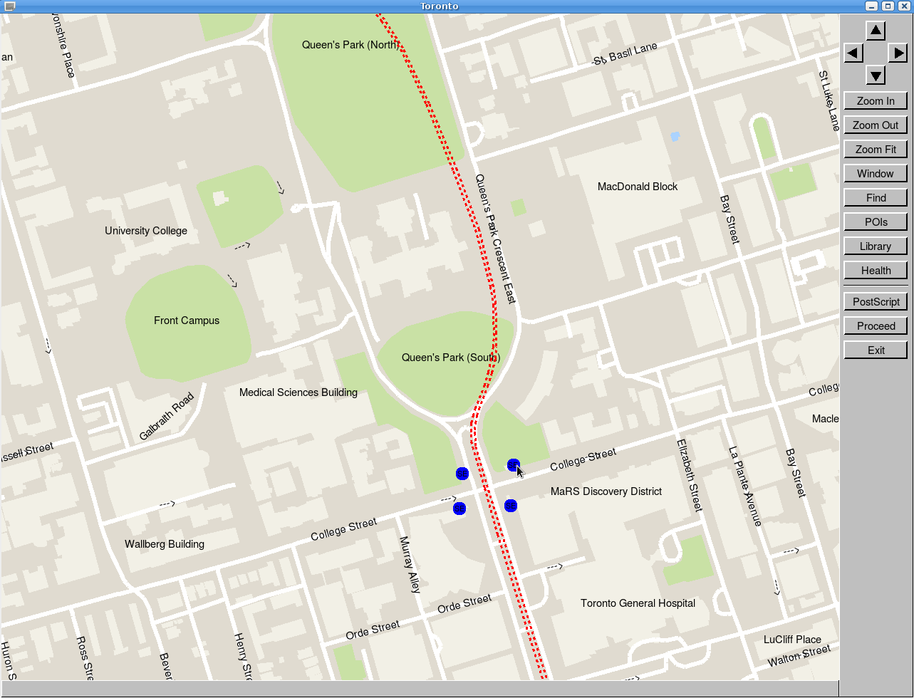
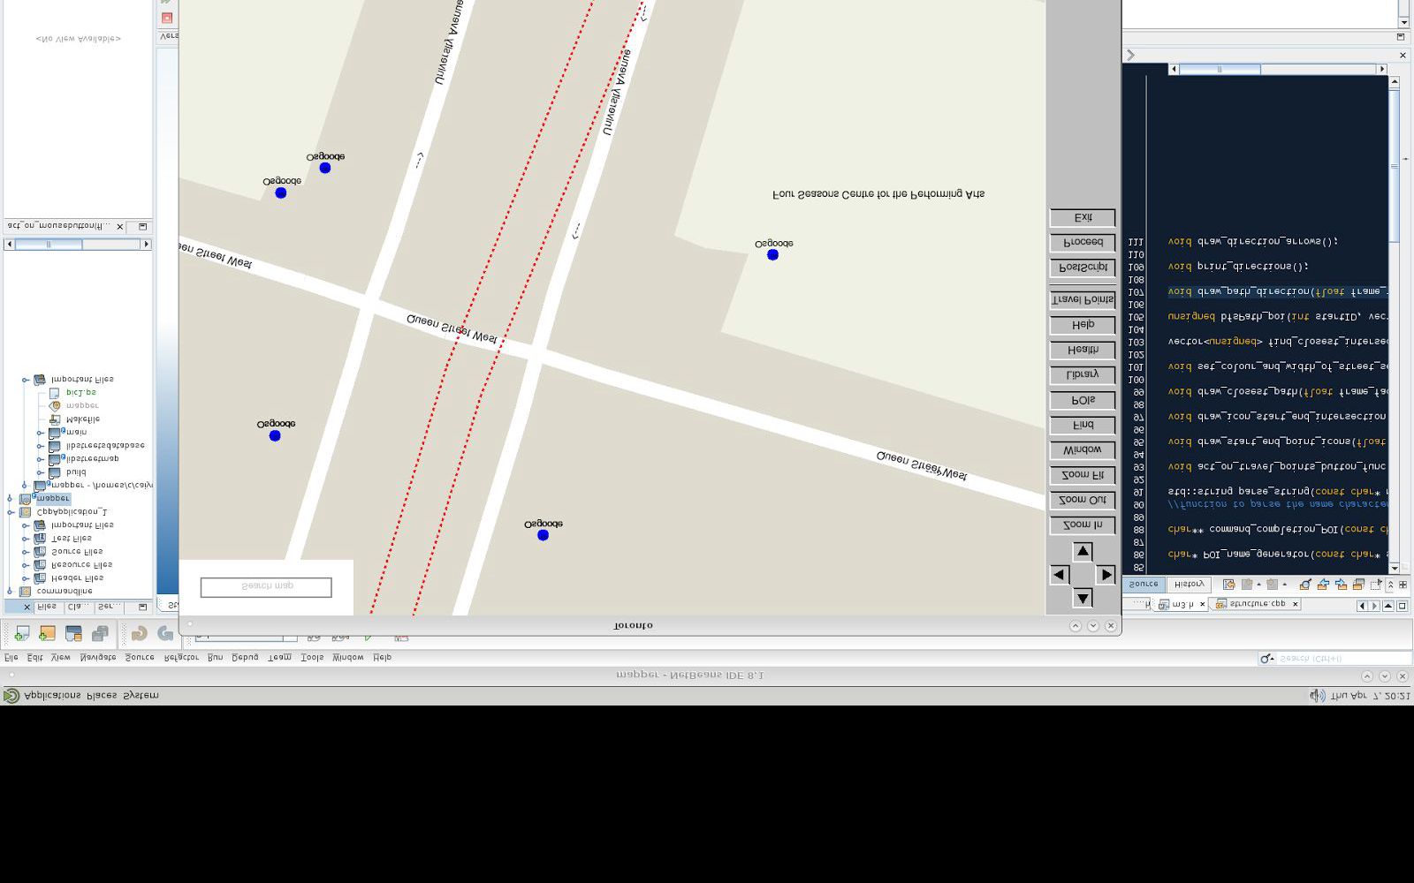
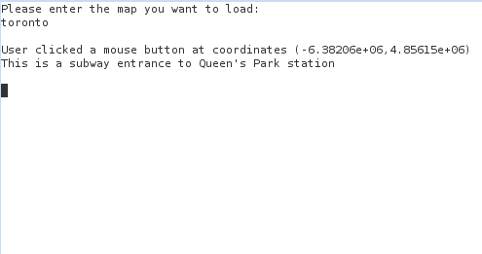
Subway station name
To travel with our map
Yuxi (June) Cai
Click on the station
Zoom in

Slide 10
Navigation Information
To travel with our map
Yuxi (June) Cai
Intersection to intersection
Click on screen
Type in names
Intersection to POI

Slide 11
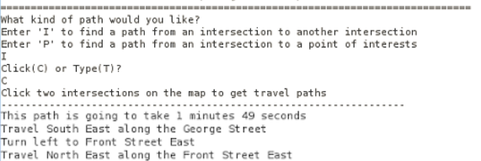
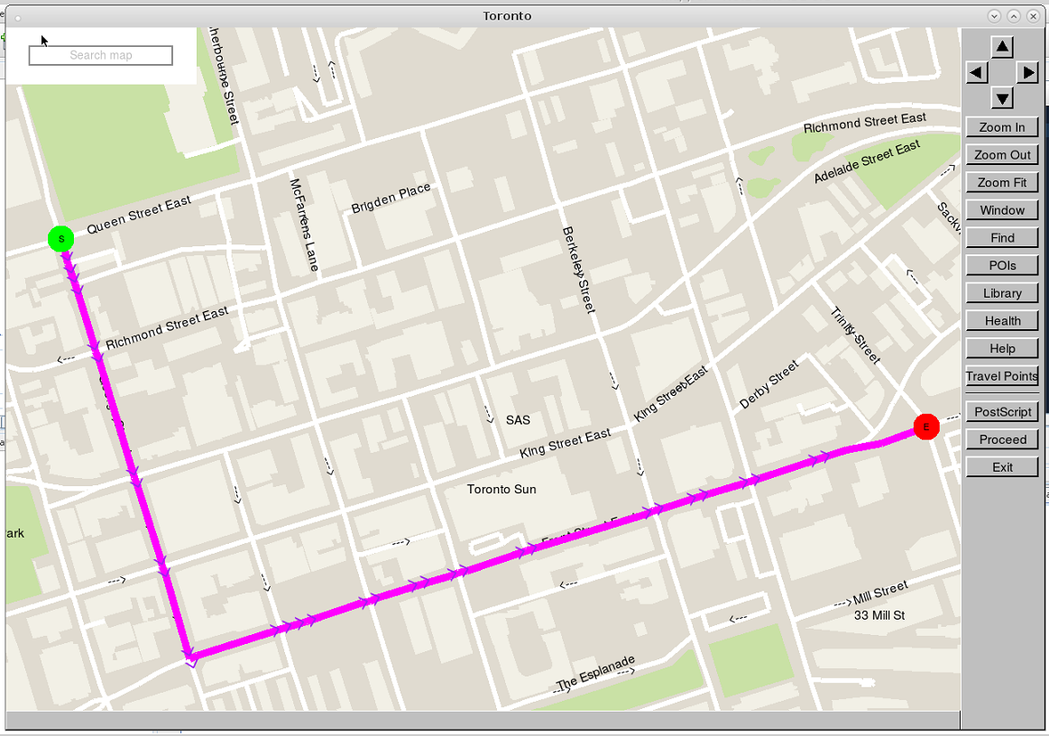
Navigation Information
To travel with our map
Yuxi (June) Cai
Figure 9-10: Sample Navigation information output

Slide 12
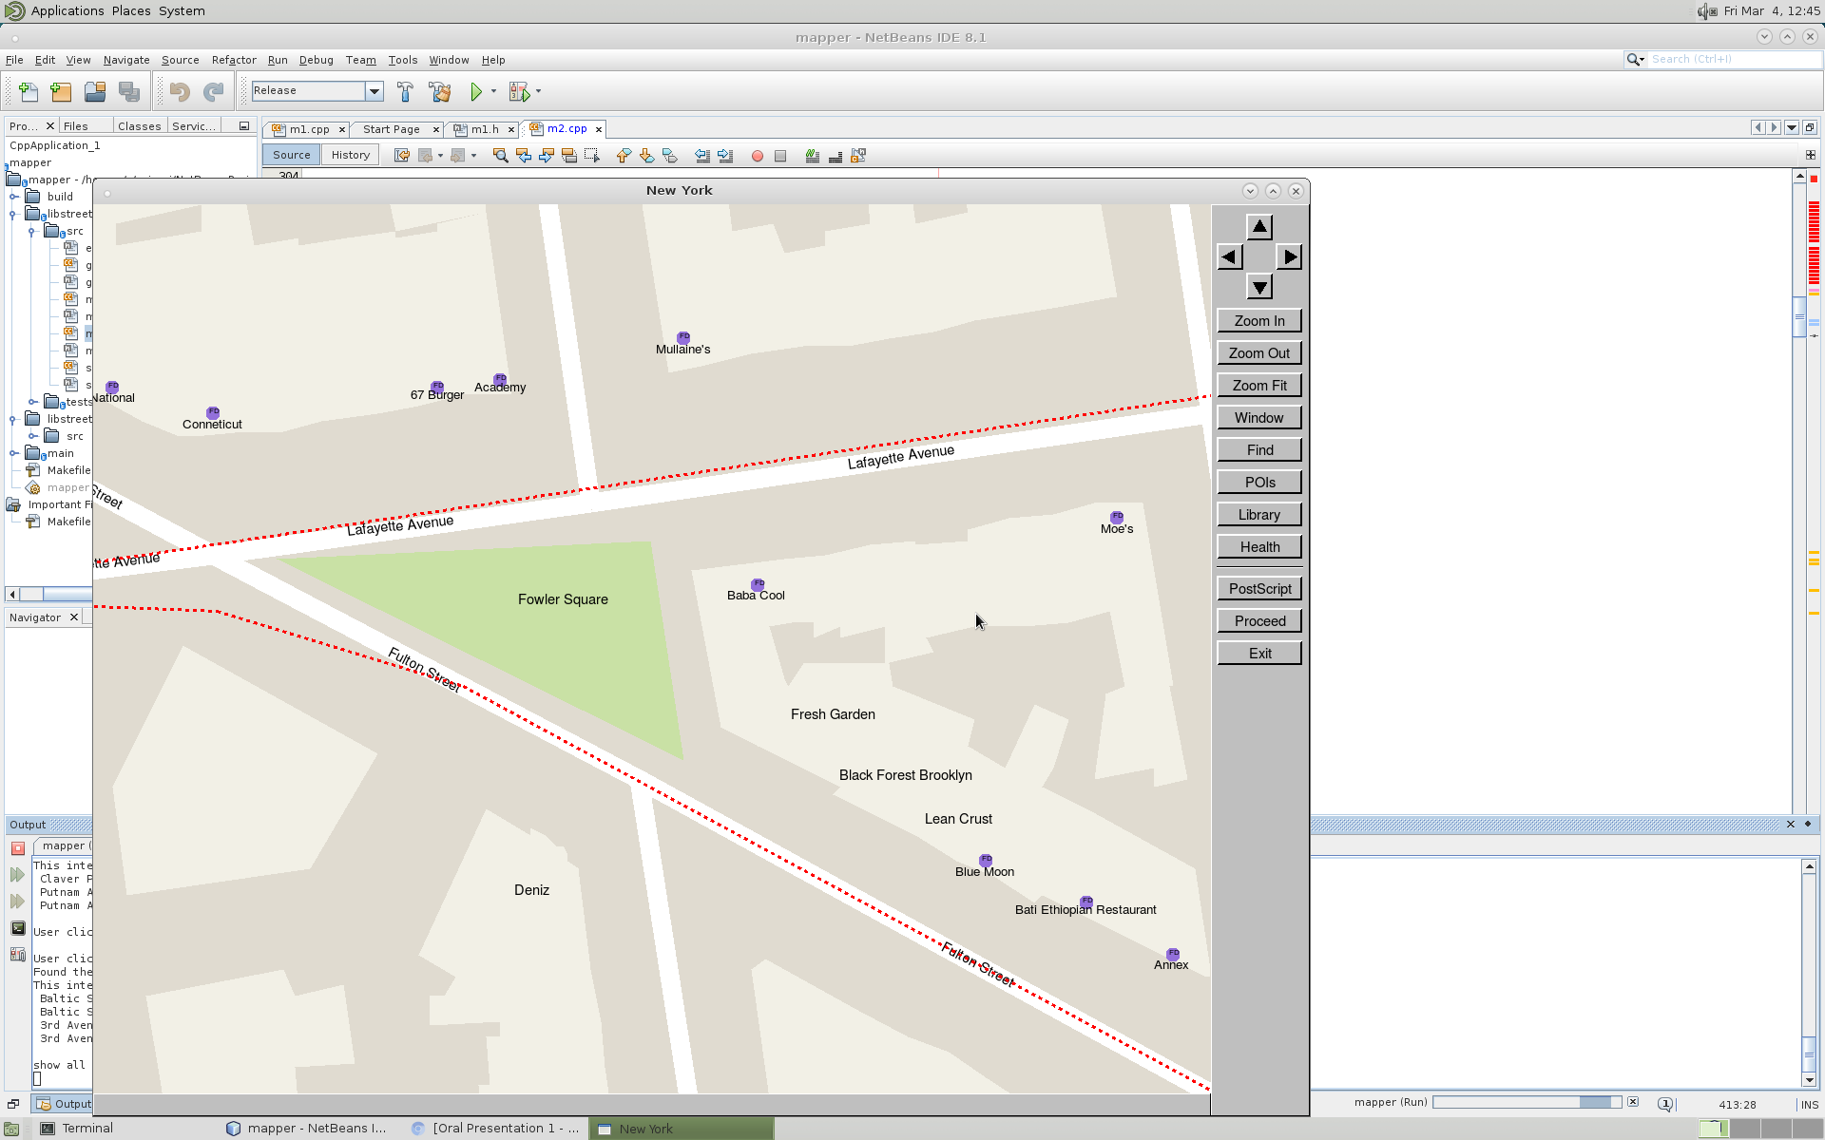
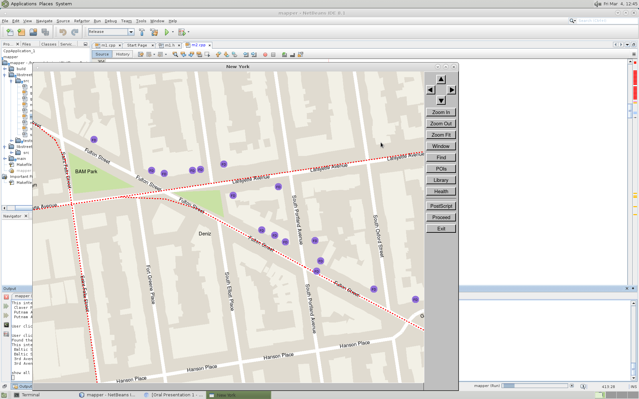
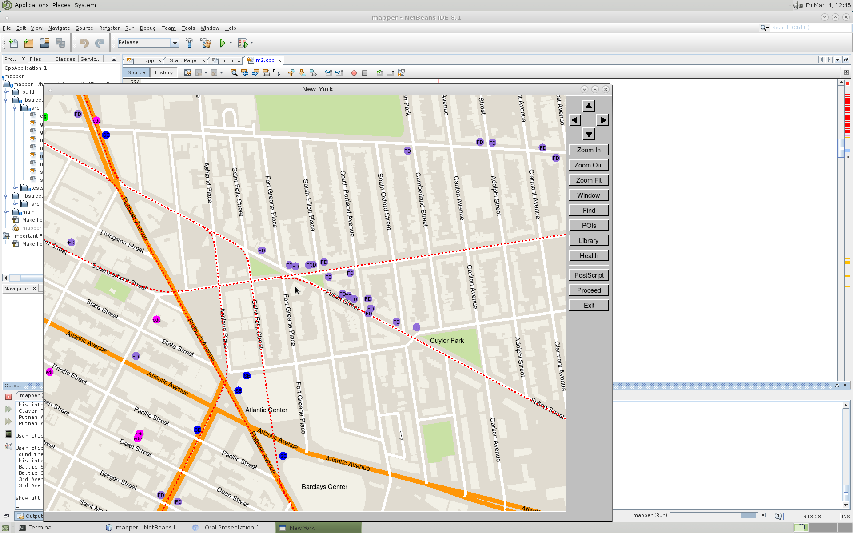
Levels of Detail
Clear-layout
Yuxi (June) Cai
Figure 11-14: Levels of details in different zoom levels
13

Slide 13
Avoiding Human Error
User-friendly
Yuxi (June) Cai
Human Error: primary cause of accidents in a large range of industry [3]
What if the user doesn’t input the commands we assume they would input?
[3] J. Senders and N. Moray, Human error. Hillsdale, N.J.: L. Erlbaum Associates, 1991.

Slide 14
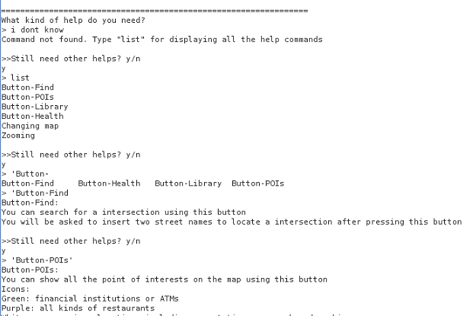
Human Error Solution
User-friendly
Yuxi (June) Cai
Figure 15: Output from help button

Slide 15
Response Time
Responsive
Yuxi (June) Cai
Test name | Numerical result | User experience*
Intersection to intersection algorithm | 0.0172s | The path is found simultaneously
Intersection to POI algorithm | 0.0438s | The path is found simultaneously.
draw-screen | 0.044s-0.12s | Map is drawn almost simultaneously.
* Note: 0.1 second is the time limit for users to feel a reaction happens simultaneously and the result from autotester is below the limit [1].
[2] J. Nielsen (1999). “Response Times: The 3 Important Limits” [Online] Accessed April 6, 2016. Available: https://www.nngroup.com/articles/response-times-3-important-limits/.

Slide 16
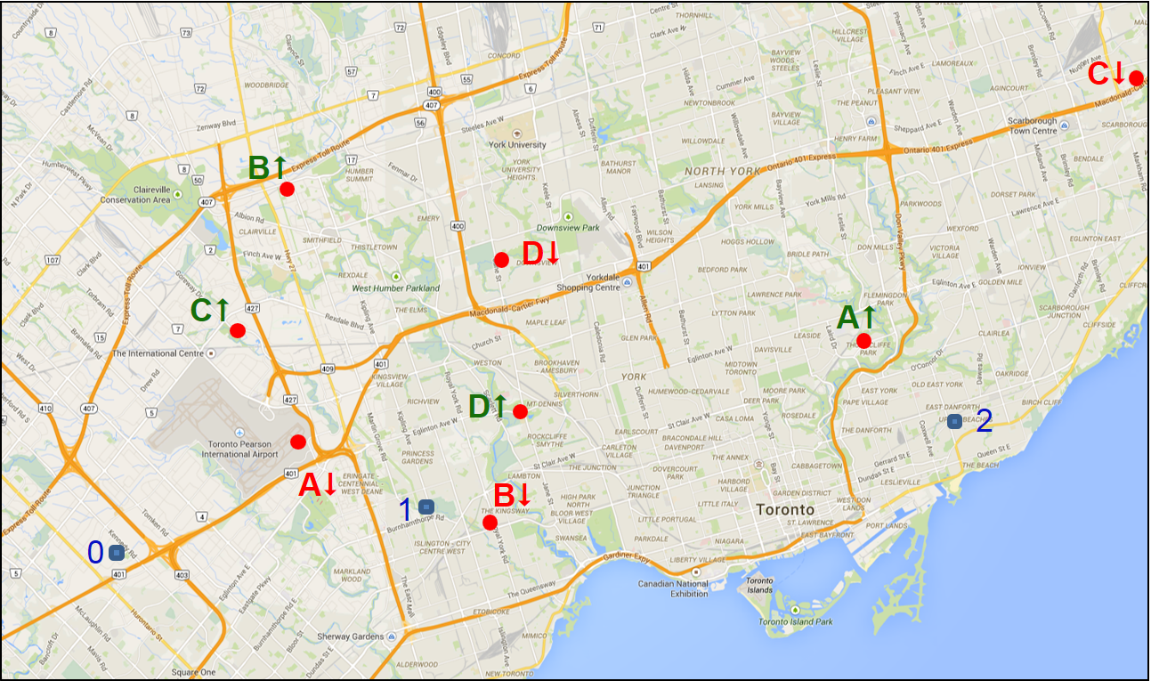
Key innovations
Technical aspects
Jixiong(Jason) Deng
Multithreading
Load map information
Shortest path problem
Two fixed points
One fixed point
Traveling salesman problem
[4] ECE 297, Lecture #18, "Traveling Courier 2", 2016
Figure 16-18: Example of traveling salesman problem [4]

Slide 17
Data structures
Multithreading
Jixiong(Jason) Deng
Street Informations (Vector)
Intersections IDs
Street segments IDs
Intersection informations (Vector)
Adjacent intersections’ IDs
Adjacent street segments’ IDs
Point of Interests information (Vector)
Nearest intersection ID
Street name information (Multimap)
Street IDs

Slide 18
Linear loading v.s. Multithreading
Multithreading
Jixiong(Jason) Deng
Multithreading remarkably enhance loading map’s speed
Test cases | Linear loading | Multithreading
CPU cores used | 1 | 4
Influential factor | All data structures | The biggest data structure
Loading time for London* | 32s | 69s
*Note: the loading time for london comes from public test of milestone 2

Slide 19
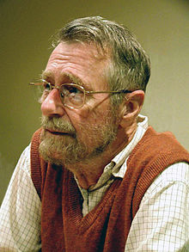
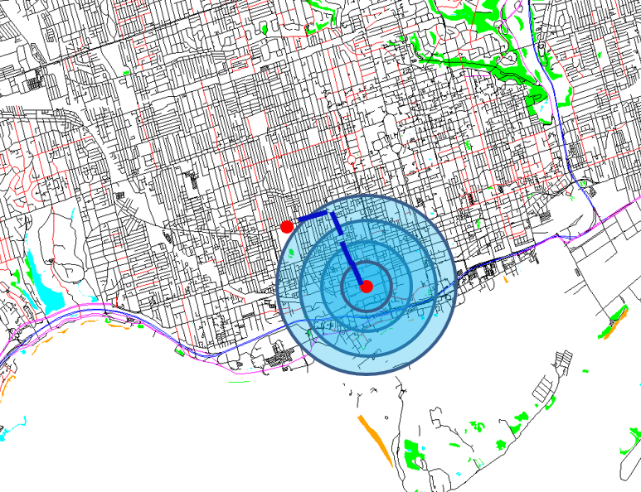
Heritage - Dijkstra algorithm
To find the shortest path
Jixiong(Jason) Deng
Invented by Edsger W. Dijkstra in 1959[5]
A Dutch computer scientist
May, 11th, 1930 ~ Aug, 6th, 2002
1972’s Turing Award Owner
Only calculate paths in expansion area[6]
Lead to the shortest path
Much faster than searching entire map
Figure19: Dijkstra’s portrait [5]
Figure 20: Example of Dijkstra’s algorithm [6]
[5] “Edsger W. Dijkstra • IEEE Computer Society,” Edsger W. Dijkstra • IEEE Computer Society. [Online]. Available at: https://www.computer.org/web/awards/goode-edsger-dijkstra. [Accessed: 10-Apr-2016].
【6] ECE 297, Lecture #15, "Breadth First Search", 2016.

Slide 20
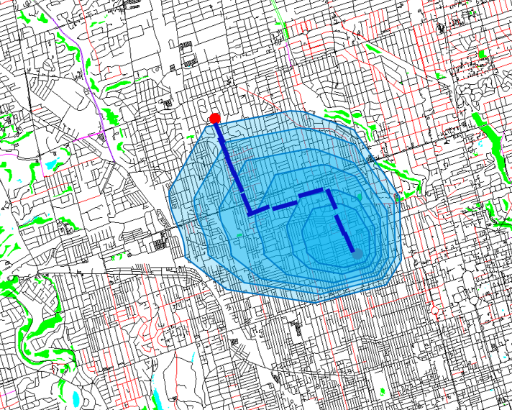
Advancement - A* algorithm
To find the shortest path
Jixiong(Jason) Deng
An extension of Dijkstra’s shortest path algorithm [7]
Improved by P. Hart, N. Nilsson and B. Raphael
First described in 1968
Advantages
Narrower expansion area
Faster calculating time
[7] “Amit’s A* Pages From Red Blob Games,” Amit’s A* Pages. [Online]. Available at: http://theory.stanford.edu/~amitp/gameprogramming/. [Accessed: 11-Apr-2016].
[8] ECE 297, Lecture #16, "Faster Graph Search", 2016
Figure 21: Example of A* algorithm [8]

Slide 21
Dijkstra v.s. A*
To find the shortest path
Jixiong(Jason) Deng
Test cases | Dijkstra’s shortest path algorithm | A* algorithm
Multiple destinations | Supported | Not Supported
Searching key | Traveling time | Heuristics method: Traveling time + Estimated time
Expansion type | Radial | Unidirectional
Calculating speed of very hard London map* | 18s | 11s
*Note: The calculating speed comes from public case “Very hard London” in milestone 3

Slide 22
Background information
To solve traveling salesman problem
Jixiong(Jason) Deng
Defined by W. R. Hamilton and Thomas Kirkman in 1800s
High complexity
O(M^2*(2N)!)
Need 1.6 * 10^77 years to solve(M =10, N =30) [9]
An unsolved problem
Need to use heuristics to solve
Focusing on optimization process
Figure 22: Example of traveling salesman problem [4]
[4] ECE 297, Lecture #18, "Traveling Courier 2", 2016

Slide 23
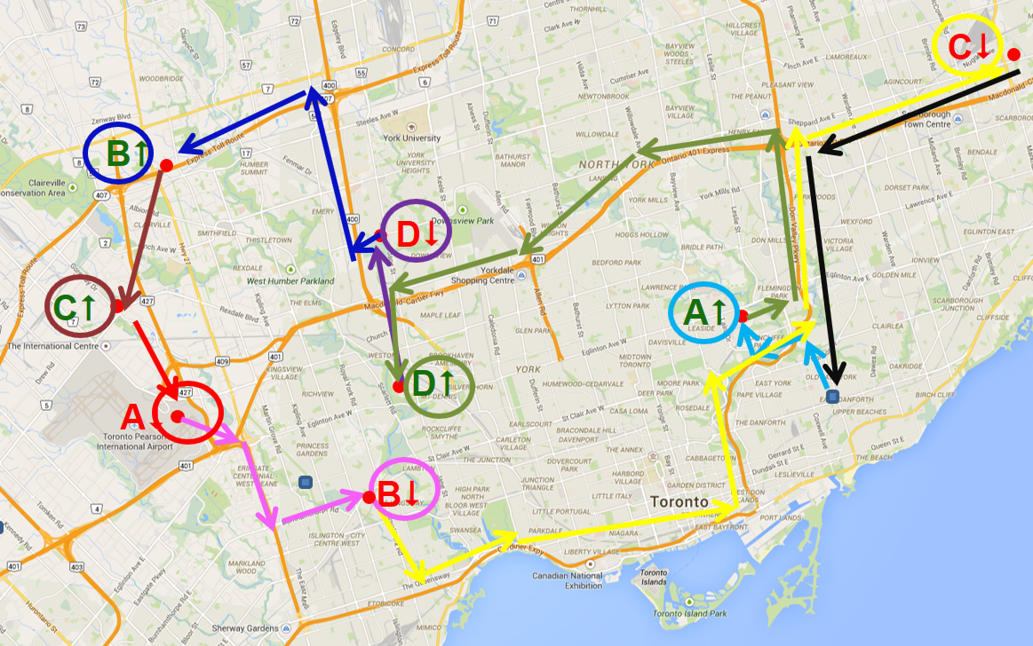
Greedy Algorithm
To solve traveling salesman problem
Jixiong(Jason) Deng
Problem solving heuristics to approach local minimal
Split complicated problem into many pieces
Compatible with shortest path algorithm
Can apply Dijkstra’s shortest path algorithm
Reduce the complexity
O(M*N*2)
Figure 23: Solution by greedy algorithm [4]
[4] ECE 297, Lecture #18, "Traveling Courier 2", 2016

Slide 24
Two-opt Optimization
To solve traveling salesman problem
Jixiong(Jason) Deng
Current visited order
Black box
New order after swapping
Check the legality of new order
If new order is illegal
If new order is legal
Calculate new traveling time
Compare new traveling time with original one
Else
If new traveling time is smaller
Record new traveling time and new order
If not finished or timeout
Figure 24: Example of traveling salesman problem

Slide 25
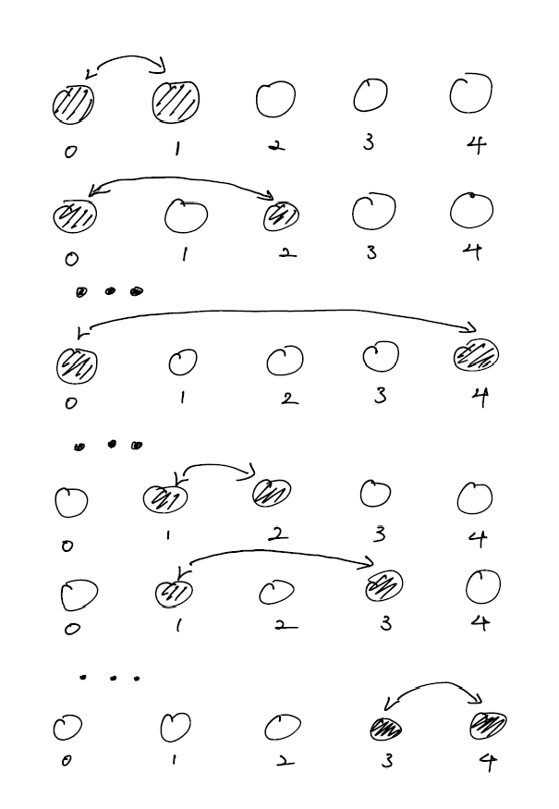
Swapping method
To solve traveling salesman problem
Jixiong(Jason) Deng
Method of exhaustion
With O((N-1)!) complexity
Lead to the best solution
Too much calculations
Small improvement in limited time

Slide 26
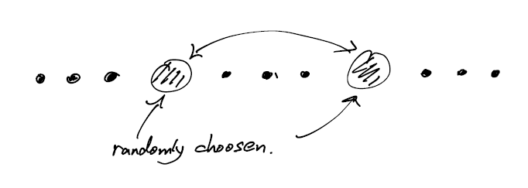
Swapping method
To solve traveling salesman problem
Jixiong(Jason) Deng
Random swapping
Infinite operations
Hard to evaluate

Slide 27
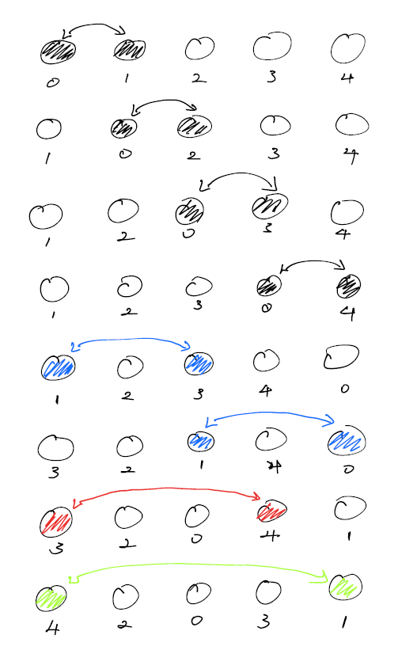
Swapping method
To solve traveling salesman problem
Jixiong(Jason) Deng
Engineered swapping
Increase randomness in limited operations
Significant improvement

Slide 28
Swapping method
To solve traveling salesman problem
Jixiong(Jason) Deng
Engineered swapping has overwhelming advantage than other two methods
Test cases | Method of exhaustion | Random swapping | Engineered swapping
Operations | (N-1)! | INF | NlogN
Terminated condition | Timeout | Timeout | Finish swapping
Improvement* | <10 | Not stable | >50
*Note: Improvement scores come from the leaderboard on http://ug251.eecg.utoronto.ca/ece297s/contest/final.html

Slide 29
Design Idea
Tony Wang
A platform for businesses to:
List items for sale, its inventory and price
A place to advertise and to spread the word
Announce sales and special deals

Slide 30
The Design will...
Tony Wang
Store information
Address
Phone number
Website
Users can compares prices
Check if the item is in stock
Get the shortest route to the store

Slide 31
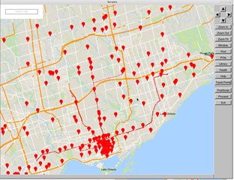


How it Works
Tony Wang
User make a search

Slide 32

How it Works
Tony Wang
Click the stores to view all the items for sale, its price and quantity remaining

Slide 33
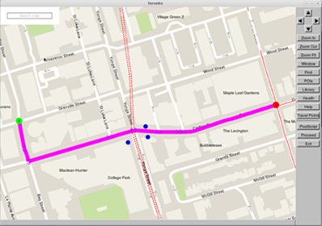
How it Works
Tony Wang
Get directions to the store

Slide 34

Target Market
Tony Wang
Small businesses
Local and family businesses
Businesses that are just starting up

Slide 35
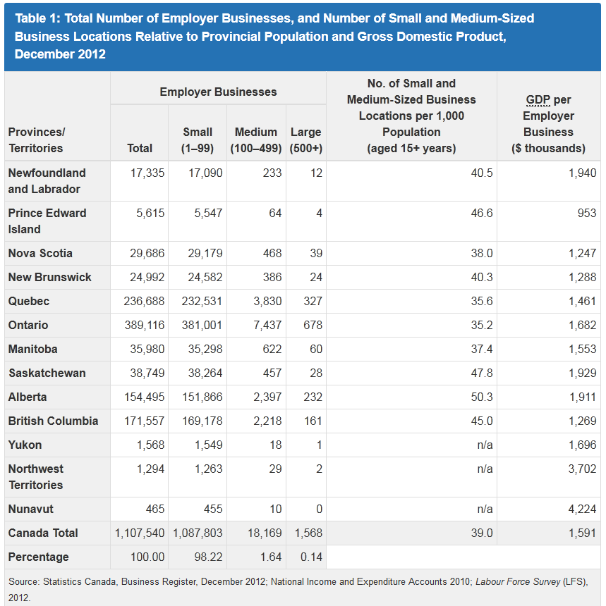
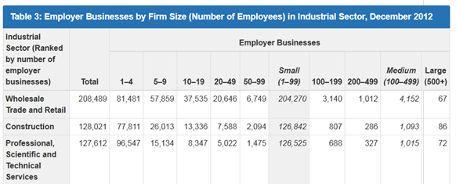
Source: S. Branch, "Key Small Business Statistics - August 2013 —How many businesses are there in Canada? - SME Research and Statistics", Ic.gc.ca, 2013. [Online]. Available: http://www.ic.gc.ca/eic/site/061.nsf/eng/02804.html.

Slide 36
How do Small Business Currently Advertise?
Tony Wang
Flyers
Posters
Value additions
Referral networks
Follow-up
Cold calling
The internet
10% Converted sales!
[9] A. Beattie, "7 Popular Marketing Techniques For Small Businesses | Investopedia", Investopedia, 2011. [Online]. Available: http://www.investopedia.com/articles/financial-theory/11/small-business-marketing-techniques.asp

Slide 37




Competitors!
Tony Wang

Slide 38



Competitors!
Tony Wang
Guide users to websites
Only online sales
Cannot compare prices
Only compare prices

Slide 39

We will have...
Tony Wang
The ability to compare prices
Identify the location of the store on the map
Find the shortest route to store
Check the quantity in stock
All in one solution!

Slide 40

Implementation Plan
Tony Wang
Gather information of stores
Address
Phone numbers
Websites
Develop product graphics menu for each store
Develop a user interface for business owners to update information
Design a website to advertise and allow users to download our GIS

Slide 41
Challenges
Tony Wang
Update item price, inventory
All data we currently use do not have to be updated
Option for business owners to update information
Problem
Currently unsure of how to approach these challenges
Taking courses in:
Computer networks
Algorithms
Operating systems

Slide 42

How will the funding be used?
Tony Wang
Advertisement campaigns
Website development
Living expenses

Slide 43
Takeaways
Tony Wang
We strived to design a GIS that is user friendly
Optimized 4 different areas:
Layout
System feedback
Speed
Features
Implemented algorithms to solve the shortest path and travelling salesman problems
Transform our GIS into a platform where businesses can list and sell their products

Slide 44
Thanks for Listening!

